Slide 1
IBM Cloud Private
Content Master Deck
Minor revisions April 20, 2018
Nate Ziemann: ziemann@us.ibm.com
Slack: @nateziemann

Slide 2
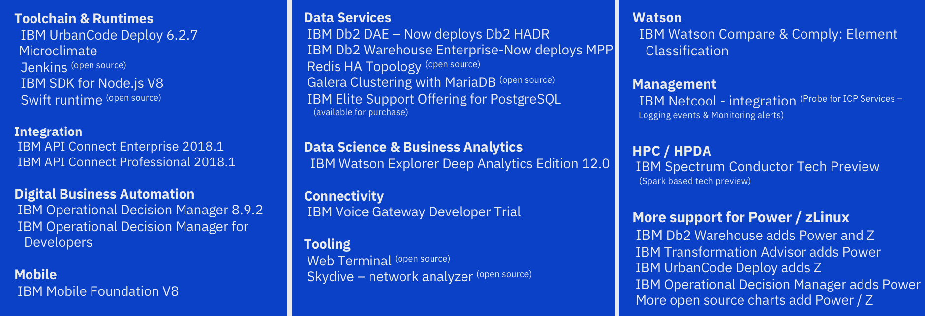
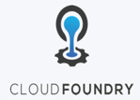
What’s new 1Q 2018
+ New and Expanded Content
Kubernetes
+ WebSphere Liberty now supports MicroProfile, Web Profile and Java EE profiles on ICP
+ Buildpack updates:
New versions of IBM buildpacks: Liberty for Java, IBM SDK for Node.js, Swift
+ Cloud Automation Manager
Introducing CAMHub. Content now available as open source hosted on github: https://ibm.biz/BdZfLs
Supported when deployed through CAM with current S&S
IBM Cloud / © 2018 IBM Corporation
2

Slide 3
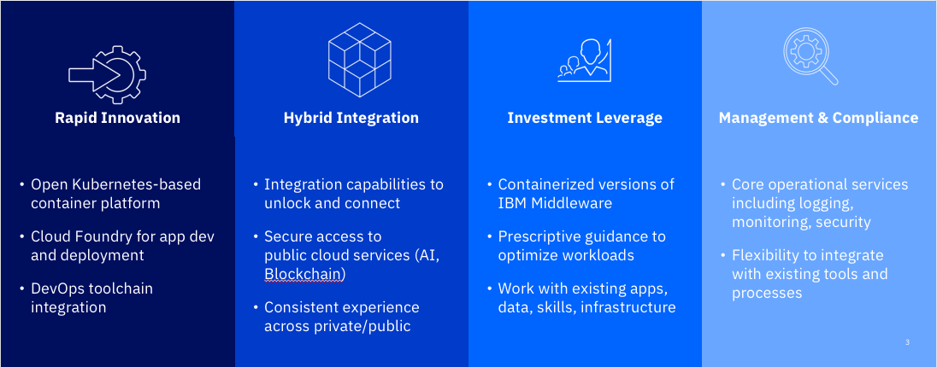
IBM Cloud Private
IBM Cloud Private brings cloud native to the enterprise

Slide 4

IBM Cloud Private Solution Overview
IBM Middleware & Open Source – e.g. Data, Analytics and Developer Services
Cloud-enabled middleware, application runtimes, messaging, databases & analytics to optimize current investments and rapidly innovate
Core Operational Services
To simplify Operations Management, Security, DevOps, and hybrid integration
Kubernetes-based Container Platform
Industry leading container orchestration platform
Cloud Foundry
For prescribed application development & deployment
Terraform (CAM)
Infrastructure as Code for multi-cloud provisioning to public and on-prem private clouds
Runs on existing IaaS:
System Z
IBM Spectrum
Dell, Cisco, NetApp, Lenovo, …
4
4
IBM Cloud / © 2018 IBM Corporation

Slide 5
IBM Cloud Private Editions
Community
Cloud Native
Enterprise
Platform
Kubernetes (+ Helm)
Core services
Content catalog (Containers)
Platform
Kubernetes (+ Helm)
Core services
Content catalog (Containers)
Platform
Kubernetes (+Helm)
Core services
Content catalog (Containers)
Cloud Foundry (Optional)
Cloud Foundry (Optional)
Freely Available in Docker Hub
IBM Enterprise Software
Microservice Builder
WebSphere Liberty
IBM SDK for node.js
Cloud Automation Manager
IBM Enterprise Software
Cloud Native Edition, plus:
WAS ND
MQ Advanced
API Connect Professional
5
IBM Cloud / © 2018 IBM Corporation

Slide 6
Content Summary for IBM Cloud Private

Slide 7

Types of Content
Container native software delivered as Docker images and Helm charts
Standard: Helm is the open standard for application packaging and deployment for Kubernetes.
Available from IBM Cloud Private Catalog. Discover & Try content is available, purchased is imported.
Kubernetes
Cloud Foundry Buildpacks provided with Cloud Foundry add-on
Standard: Cloud Foundry buildpacks provide the runtime support for applications.
Available from Cloud Foundry add-on P/N. Select IBM and community buildpacks are installable.
Template driven provisioning of private and public cloud infrastructure
Multi-cloud provisioning includes VMs, cloud native services & complex application stacks
Standard: Terraform is open source with large and growing ecosystem of major cloud vendors.
Available from Cloud Automation Manager. Includes CAMHub content for open source and enterprise software.
IBM Cloud / © 2018 IBM Corporation
7

Slide 8

Kubernetes Content
Toolchain & Runtimes
UrbanCode Deploy
Microclimate
Microservice Builder
Jenkins ^{(open source)}
IBM WebSphere Liberty (MicroProfile, Web Profile, JEE Profile)
Open Liberty ^{(open source)}
IBM SDK for Node.js
Swift runtime ^{(open source)}
Nginx ^{(open source)}
Logging & Monitoring Services
ELK ^{(open source)}
Prometheus & Grafana ^{(open source)}
App Modernization Tooling
IBM Transformation Advisor
Multi-cloud Management
IBM Cloud Automation Manager
Digital Business Automation
IBM Operational Decision Manager
IBM Operational Decision Manager for Developers
Mobile
IBM Mobile Foundation
Data Services
IBM Db2 Direct Advanced Edition / AESE with
Data Server Manager
IBM Db2 Dev-C
IBM Data Server Manager (for Db2 Dev-C)
IBM Db2 Warehouse Enterprise IBM Db2 Warehouse Dev-C
IBM Cloudant Developer Edition
MongoDB ^{(open source)}
PostreSQL ^{(open source)}
MariaDB ^{(open source)}
Galera clustering with MariaDB ^{(open source)}
Redis HA Topology ^{(open source)}
Messaging
IBM MQ Advanced
IBM MQ Advanced for Developers
Rabbit MQ ^{(open source)}
Integration
IBM Integration Bus
IBM Integration Bus for Developers
IBM DataPower Gateway Virtual Edition
IBM DataPower Gateway for Developers
IBM API Connect Professional
IBM API Connect Enterprise
Watson
IBM Watson Compare & Comply: Element
Classification
Data Science and Business Analytics
IBM Data Science Experience Local
IBM Data Science Experience Developer Edition
IBM Watson Explorer Deep Analytics Edition
Data Governance and Integration
IBM InfoSphere Information Server
for Evaluation
Management
IBM Netcool - integration ^{(Probe for ICP Services –}
Logging events & Monitoring alerts)
Connectivity
IBM Voice Gateway Developer Trial
Tooling
Web Terminal ^{(open source)}
Skydive – network analyzer ^{(open source)}
HPC / HPDA
IBM Spectrum LSF Community Edition
IBM Spectrum Symphony Community Edition
IBM Spectrum Conductor Tech Preview
+
Catalog content is not distributed with IBM Cloud Private. Content is distributed separately, licensed under separate terms and conditions.
IBM Cloud / © 2018 IBM Corporation
8

Slide 9
Multi-Cloud and Cloud Foundry Content
Extend workload provisioning with Cloud Automation Manager
Template driven provisioning of private and public cloud infrastructure: Bare-metal servers, VMs, cloud native services & complex application stacks
Open Source Library
Enterprise Library
Buildpacks
MEAN stack – VMware, IBM Cloud, Azure, AWS
LAMP stack – VMware, IBM Cloud, Azure, AWS
Node.js – VMware, IBM Cloud
Strongloop – VMware, IBM Cloud
MariaDB - VMware
MongoDB – VMware, IBM Cloud
MongoDB Strongloop 3 tier – VMware, IBM Cloud
Virtual Servers with SSH key – IBM Cloud, AWS
Apache HTTP Server - VMware, IBM Cloud, AWS
Apache Tomcat – VMware, IBM Cloud, AWS
IBM DB2 EE (v10.5 & v11.1)
IBM MQ (v8 & v9)
IBM WebSphere Application Server ND (v8.5.5, v9.0)
IBM WebSphere Liberty (v17)
IBM HTTP Server (v8.5.5, v9)
Oracle DB Enterprise (v12c)
Oracle MySQL (v5.7)
All deployable to VMware, IBM Cloud, AWS
IBM
Liberty for Java
SDK for Node.js
Runtime for Swift
ASP.NET Core
Community
Consistent with IBM Cloud
Automation content available with IBM Cloud Private purchase. Product licenses must be purchased separately or BYOL. See pricing and packaging for more information.
+Community Templates
Terraform Module Registry
+Bring your own
Self written, IBM Cloud Schematics, etc
+Bring your own
Now available on CAMHub as open source https://ibm.biz/BdZfLs
IBM Cloud / © 2018 IBM Corporation
9

Slide 10
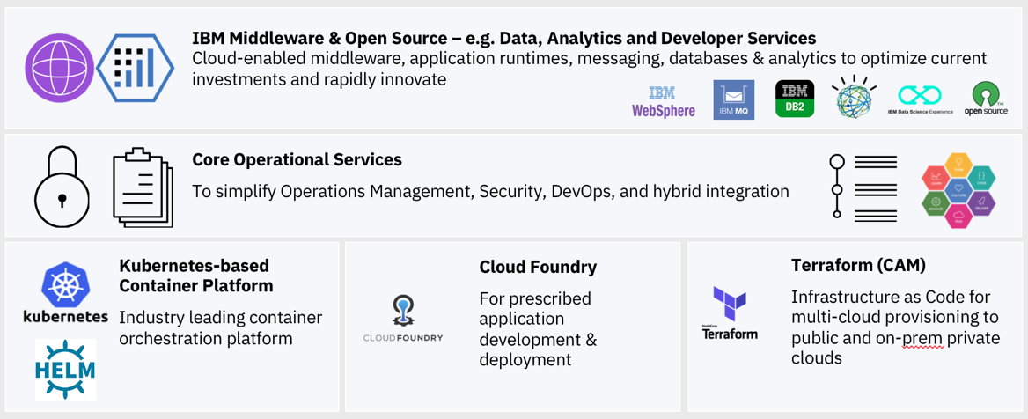
IBM Software enhanced for IBM Cloud Private Integrated while running outside of the platform
Manage
Connect
IBM UrbanCode Deploy
IBM API Connect
Monitor
IBM Netcool Operations Insight |
IBM Application Performance Management
10
IBM Cloud / © 2018 IBM Corporation

Slide 11
IBM Cloud Private
Catalog and Kubernetes Content

Slide 12
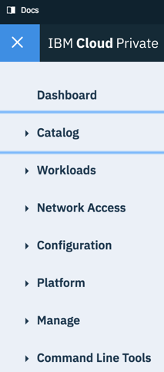


Catalog Overview
IBM Cloud Private Catalog provides simple, self service, access to IBM and Open Source software built for Kubernetes
Discover and try software quickly
Deploy with a few clicks
Extend to include your apps, community and commercial software
Control which software is included in the catalog
12
IBM Cloud / © 2018 IBM Corporation

Slide 13
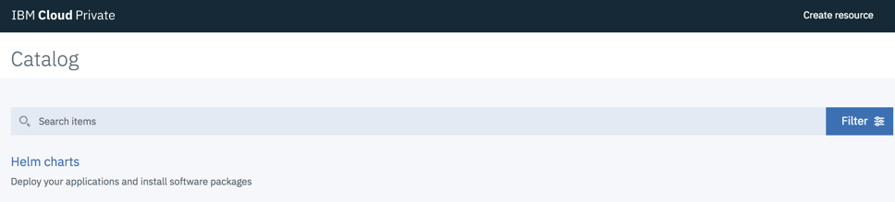
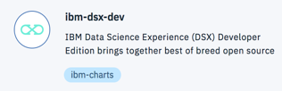
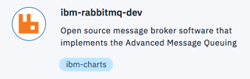

What is the Catalog today?
Collection of deployment packages (Helm Charts) displayed as tiles with a simple UX to view and deploy software.
The Catalog provides access to software under separate license terms.
13
IBM Cloud / © 2018 IBM Corporation
Notes:
Out of the Box, Two repositories are included:
IBM Charts – Publicly available, hosted on github.com/ibm/charts
Local Charts – Installed with IBM Cloud Private

Slide 14
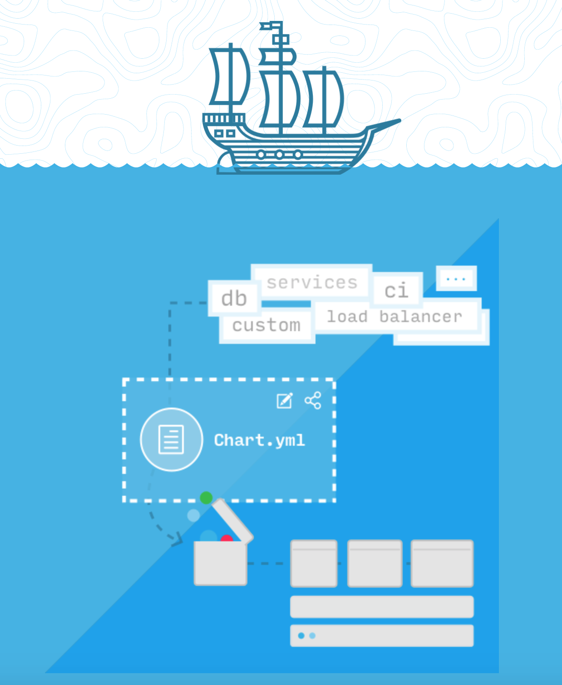

What is Helm?
The package manager for Kubernetes
Helm is the open standard for Application Packaging and Deployment for Kubernetes.
Helm charts can describe the most complex software built for Kubernetes: Resources, dependencies, variables, image locations.
Find more about Helm at https://helm.sh/

Slide 15



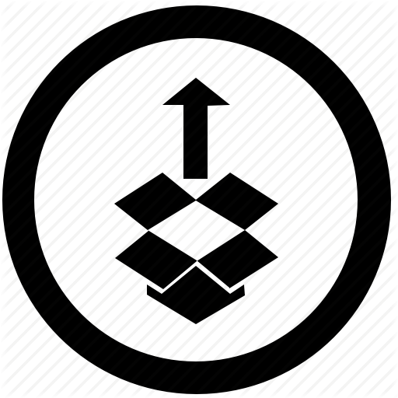


Why IBM is standardizing on Helm?
Standard
Open
Sharable
Adopted
Helm is the package manager for Kubernetes
Maintained by Cloud Native Computing Foundation, avoiding vendor lock-in
Easy to version, share, &
host on public or private repos. Find IBM’s at github.com/ibm/charts
Industry adopted (IBM, Microsoft, Google, Bitnami, open source)
5000+ Github Stars
Manage Complexity
Consistent Lifecycle Operations
Charts describe even the most complex apps. Provides simple and repeatable install. Serves as a single source of truth
Consistent deploy, upgrade & rollback operations for all your Kubernetes based software

Slide 16

Discover and Try Software
Discover and Try helm charts reside in the
IBM Charts Repository on github.com/ibm/charts
IBM Cloud Private
Catalog
Helm/Tiller
Kubernetes
Available from catalog in all IBM Cloud Private offerings,
including Community Edition. Not shipped with the product.
Client accepts separate license terms: open source,
IBM ILAN or ILAE licensed.
Content is continuously updated, automatically
available to client’s catalog upon refresh.
Docker images are sourced from public Docker registries.
Requires internet connectivity.
Documented process for disconnected mode (Knowledge Center)
Charts are stored in a helm repository
Located on github.com/ibm/charts
Charts reference Docker images
Helm charts
Located in Docker registries
-Dockerhub
-Dockerstore
Docker images
16
IBM Cloud / © 2018 IBM Corporation
Notes:
The IBM Cloud Private license indicates: Program allows Licensee to access and download additional IBM and non-IBM software. Entitlement to additional software is obtained separately from the Program and will have separate terms. Licensee agrees that those terms may be presented only in English.

Slide 17
Adding Purchased IBM Software to your Catalog
Purchased IBM Software is entitled in PPA
1. Download from Passport Advantage
2. Import locally into IBM Cloud Private (ICP)
Purchased IBM software is provided with IPLA license.
Some software maybe sold with priced metrics other than VPC. Client is responsible for compliance to those metrics.
Several packages are entitled for production use and S&S through ICP Cloud Native and Enterprise editions, but are only accessed from IBM Charts repo and public Docker registries. This includes Microservice Builder, WebSphere Liberty and Node.js runtimes.
IBM Cloud Private
Catalog
Helm/Tiller
Kubernetes
+ Chart
+ images
Import
Local Helm Repository
Installed with ICP
Helm charts
Archive
(tar.gz)
Local Docker Registry
Installed with ICP
Docker images
17
IBM Cloud / © 2018 IBM Corporation

Slide 18
Content available by Edition
Discover and Try software available in all editions
IBM Cloud Private Cloud Native
IBM Cloud Private Enterprise
Toolchain & Runtimes
Microclimate
Microservice Builder
Jenkins (open source)
IBM WebSphere Liberty
Open Liberty (open source)
IBM SDK for Node.js
Swift runtime sample (open source)
Nginx (open source)
Messaging
MQ Advanced for Developers
RabbitMQ (open source)
Integration
IBM Integration Bus for Developers
IBM DataPower Gateway for Developers
Data Services
IBM Db2 Dev-C
IBM Db2 Warehouse Dev-C
IBM Data Server Manager (for Db2 Dev-C)
IBM Cloudant Developer Edition
MongoDB (open source)
PostgreSQL (open source)
MariaDB (open source)
Galera clustering with MariaDB (open
source)
Redis HA Topology (open source)
Catalog of Discover & Try content, plus …
Toolchain & Runtimes
Microservice Builder ^{[1]}
IBM WebSphere Liberty ^{[1]}
IBM SDK for Node.js ^{[1]}
Multi-Cloud Management
IBM Cloud Automation Manager ^{[1]}
Cloud Native content, plus…
Runtimes
IBM WebSphere Application Server ND ^{[1] [2]}
Messaging
IBM MQ Advanced ^{[1]}
Integration
IBM API Connect Professional ^{[1] [2]}
Data Science
IBM Data Science Experience Developer
Edition
Data Governance and Integration
IBM InfoSphere Information Server
for Evaluation
App Modernization Tooling
IBM Transformation Advisor
Digital Business Automation
IBM Operational Decision Manager
Developer Edition
Connectivity
IBM Voice Gateway Developer Trial
Management
IBM Netcool -integration ^{(Probe for ICP Services}
-Logging events & Monitoring alerts)
HPC / HPDA
IBM Spectrum LSF Community Edition
IBM Spectrum Symphony Community
Edition
IBM Spectrum Conductor Tech Preview
Tooling
Web Terminal (open source)
Skydive Network Analyzer (open source)
[1] IBM Software bundled with Cloud Native or Enterprise editions is entitled for production use with subscription and support.
[2] Runs on VMs
outside of Kubernetes
Data Services
IBM Db2 Direct Advanced Edition
IBM Db2 Warehouse Enterprise
(in ICP for Data Science PN)
Data Science
IBM Data Science Experience Local
Toolchain
IBM UrbanCode Deploy (now on ICP)
Cloud Foundry
Includes select buildpacks
Optional add-ons to
Cloud Native or Enterprise
Messaging
IBM MQ Advanced
Integration
IBM Integration Bus
IBM DataPower Gateway Virtual Ed
IBM API Connect Enterprise
IBM API Connect Professional
Watson
IBM Watson Compare & Comply: Element Classification
Data Services
IBM Db2 Direct Advanced Ed. / AESE
with IBM Data Server Manager
IBM Db2 Warehouse Enterprise
Data Science & Business Analytics
IBM Watson Explorer Deep Analytics Edition
Digital Business Automation
IBM Operational Decision Manager
Mobile
IBM Mobile Foundation
Available a la carte
Separate purchase or
bring your existing license
18
Catalog content is not distributed with IBM Cloud Private. Content is distributed separately, licensed under separate terms and conditions.
*coming soon
Notes:
ICP License explicitly states the following about software available through the catalog: “Program allows Licensee to access and download additional IBM and non-IBM software. Entitlement to additional software is obtained separately from the Program and will have separate terms. Licensee agrees that those terms may be presented only in English.”

Slide 19
Cloud Automation Manager and Terraform Content

Slide 20
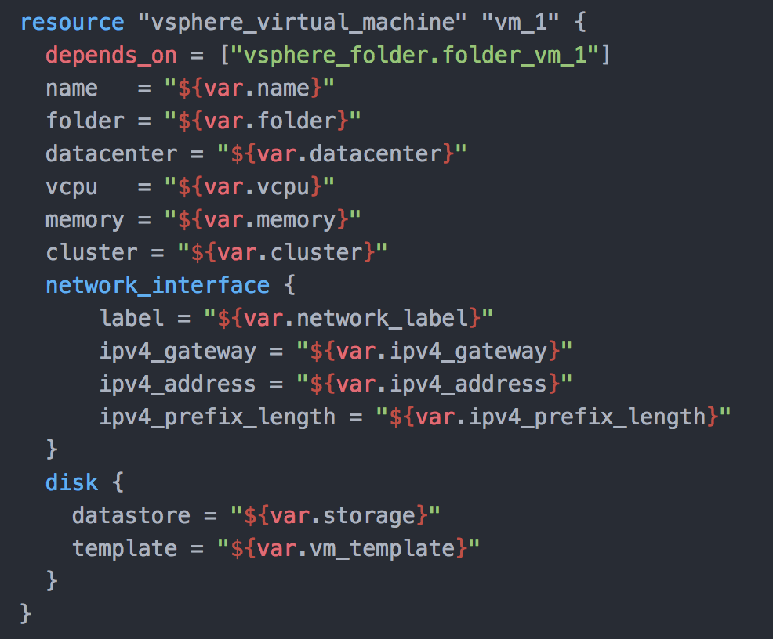
Why Terraform
Declarative Cloud Automation
Common approach in all clouds
All clouds and all application architectures
Open source
10,000+ GitHub stars; 1,153 contributors
Supported by major cloud vendors
Large & growing ecosystem
Terraform Module Registry
Many OEM providers and provisioners
Enterprise hardened by IBM
Secrets management
Role based provisioning
Team development
IBM Cloud / © 2018 IBM Corporation

Slide 21
Cloud Automation Manager
Common approach to automate all workloads in all clouds repeatably and efficiently
Manage infrastructure as code
Use a text or graphical editor to define simple VMs to full environments
Declarative - focus on the what, not the how
Standardize delivery: Efficiency & control
Multi-Cloud Content Library
Leverage IBM, community and home-grown assets as building blocks
Modernize legacy applications, build new cloud native applications
Bring cloud services to existing apps.
Bind datacenter services to cloud apps.
Install and provision ICP; deliver ICP as a service
IBM Cloud / © 2018 IBM Corporation

Slide 22
Terraform Content
Now Available on CAMHub as open source https://ibm.biz/BdZfLs
Open Source Library
MEAN stack – VMware, IBM Cloud, Azure, AWS
LAMP stack – VMware, IBM Cloud, Azure, AWS
Node.js – VMware, IBM Cloud
Strongloop – VMware, IBM Cloud
MariaDB - VMware
MongoDB – VMware, IBM Cloud
MongoDB Strongloop 3 tier – VMware, IBM Cloud
Virtual Servers with SSH key – IBM Cloud, AWS
Apache HTTP Server - VMware, IBM Cloud, AWS
Apache Tomcat – VMware, IBM Cloud, AWS
Enterprise Library
IBM DB2 EE (v10.5 & v11.1)
IBM MQ (v8 & v9)
IBM WebSphere Application Server ND (v8.5.5, v9.0)
IBM WebSphere Liberty (v17)
IBM HTTP Server (v8.5.5, v9)
Oracle DB Enterprise (v12c)
Oracle MySQL (v5.7)
All deployable to VMware, IBM Cloud, AWS
Automation content available with IBM Cloud Private purchase. Product licenses must be purchased separately or BYOL. See pricing and packaging for more information.
+Community Templates (Terraform Module Registry)
+Bring your own (Self written, IBM Cloud Schematics, …)
Supported when deployed through CAM with current S&S
IBM Cloud / © 2018 IBM Corporation

Slide 23
Kubernetes Content Details

Slide 24
Sold Separately Details
Products | Sold Separately |  | Available from IBM Cloud Private (PID 5737-E67)
 | PID | Priced Metrics | Edition | Part Numbers | Priced Metrics
IBM MQ Advanced 9.0.4+ | 5724-H72 | VPC monthly term PVU perpetual | ICP Enterprise | D1VXSLL E0P1MLL | VPC monthly term VPC perpetual
IBM Integration Bus 10.0.0.10 | 5724-J05 | VPC monthly term PVU perpetual | None
IBM DataPower Gateway Virtual Edition 7.6.0 (Includes production use & non-production use images) | 5724-T09 | PVU monthly term PVU perpetual | None
IBM Db2 Direct Advanced Edition 11.1.2 with DSM | 5725-Z99 | VPC monthly term | (optional Add-on) Cloud Native or Enterprise | DVYMLL | VPC monthly term
IBM Db2 Advanced Enterprise Server Ed. 11.1.2 with DSM | 5725-L47 | PVU perpetual | None
IBM Db2 Warehouse Enterprise 2.0.0 | 5725-Z65 | VPC monthly term VPC perpetual | ICP for Data Science, contains CN+Db2 Warehouse | D1VSRLL D1VSDLL | VPC monthly term VPC perpetual
IBM Data Science Experience Local 1.1.1+ | none | none | (optional Add-on) Cloud Native or Enterprise | D1VSTLL D1VSHLL | AU monthly term AU perpetual
IBM Mobile Foundation 8.0 announcement | 5725-I43 | per app and per Addressable device | None
IBM Operational Decision Manager 8.9.2 announcement | 5725-B69 | VPC monthly term PVU perpetual | None
IBM UrbanCode Deploy 6.2.7 | 5727-M54 | VPC monthly term VPC perpetual
IBM Watson Compare and Comply: Element Classification 1.0.1 announcement sales enablement | 5737-H24 | VPC monthly term VPC perpetual | None
IBM API Connect Enterprise 2018.1 announcement | 5725-Z22 | PVU perpetual, API Call volume measured yearly | None
IBM API Connect Professional 2018.1 announcement | 5725-Z22 | PVU perpetual, API Call volume measured yearly | ICP Enterprise
IBM Watson Explorer Deep Analytics Edition 12.0 OneWEX chargeable component. | 5725-I17 | PVU perpetual | None
24
IBM Cloud / © 2018 IBM Corporation

Slide 25
Kubernetes Content Matrix
 | Products | Available from Catalog | Sold Separately | Architectures
 |  | In all editions | Add-on / a la carte | x86-64 | Power LE | zLinux
Data Services | IBM Db2 Dev-C 11.1.2 | ⚫️ |  | ⚫️ | ⚫️ | ⚫️
 | IBM Data Server Manager 2.1.4 for use with Db2 Dev-C | ⚫️ |  | ⚫️ | ⚫️ | ⚫️
 | IBM Db2 Direct Advanced Edition 11.1.2 with DSM |  | ⚫️ | ⚫️ | ⚫️ | ⚫️
 | IBM Db2 Advanced Enterprise Server Ed. 11.1.2 with DSM |  | ⚫️ | ⚫️ | ⚫️ | ⚫️
 | IBM Db2 Warehouse Dev–C 2.0.0 | ⚫️ |  | ⚫️ | ⚫️ | ⚫️
 | IBM Db2 Warehouse Enterprise 2.0.0 |  | ⚫️ | ⚫️ | ⚫️ | ⚫️
 | IBM Cloudant Developer Edition 2.0.1 | ⚫️ |  | ⚫️
 | MongoDB * | ⚫️ |  | ⚫️ | ⚫️ | ⚫️
 | PostgreSQL* | ⚫️ |  | ⚫️ | ⚫️ | ⚫️
 | MariaDB * | ⚫️ |  | ⚫️ | ⚫️ | ⚫️
 | Galera clustering with MariaDB * | ⚫️ |  | ⚫️ | ⚫️
 | Redis with HA Topology * | ⚫️ |  | ⚫️ | ⚫️
Data Science & Business Analytics | IBM Data Science Experience Developer Edition 1.1.1 | ⚫️ |  | ⚫️ | ⚫️
 | IBM Data Science Experience Local 1.1.1 |  | ⚫️ | ⚫️ | ⚫️
 | IBM Watson Explorer Deep Analytics Edition 12.0 |  | ⚫️ | ⚫️
Toolchains & Runtimes | IBM UrbanCode Deploy Server 6.2.7 |  | ⚫️ | ⚫️ |  | ⚫️
 | Microclimate 2018.3 (free tooling) | ⚫️ |  | ⚫️
 | Microservice Builder 2.1 ^{[1]} | ⚫️ |  | ⚫️ | ⚫️
 | Jenkins * | ⚫️ |  | ⚫️ | ⚫️
 | IBM WebSphere Liberty 17.0, 18.0 ^{[1]} MicroProfile, Web Profile, Java EE profiles deployed on ICP | ⚫️ |  | ⚫️ | ⚫️ | ⚫️
 | IBM SDK for Node.js V6, V8 ^{[1]} | ⚫️ |  | ⚫️ | ⚫️ | ⚫️
 | Open Liberty * | ⚫️ |  | ⚫️
 | Swift runtime * | ⚫️ |  | ⚫️ |  | ⚫️
 | Nginx * | ⚫️ |  | ⚫️ | ⚫️ | ⚫️
Modernization Tools | IBM Transformation Advisor 1.4 (free tooling) | ⚫️ |  | ⚫️ | ⚫️
Catalog content is not distributed with IBM Cloud Private. Content is distributed separately, licensed under separate terms and conditions.
25
[1] Content included as a supporting program in IBM Cloud Private Cloud Native and Enterprise editions.
*Open Source packages are not supported. Deployment of open source helm charts through the IBM Cloud Private catalog are supported.

Slide 26
Kubernetes Content Matrix
 | Products | Available in Catalog | Sold Separately | Architectures
 |  | In all editions | Add-on / a la carte | x86-64 | Power LE | zLinux
Watson | IBM Watson Compare and Comply: Element Classification |  | ⚫️ | ⚫️
Multi-cloud Management | IBM Cloud Automation Manager 2.1 | ⚫️ | ⚫️ | ⚫️ | ⚫️
Management | IBM Netcool 1.4 – integration (Probe for ICP Services) | ⚫️ |  | ⚫️
Unified Governance & Integration | IBM InfoSphere Information Server for Evaluation 11.7 (DataStage, Information Analyzer, Governance Catalog) | ⚫️ |  | ⚫️
Messaging | IBM MQ Advanced for Developers 9.0.4 | ⚫️ |  | ⚫️
 | IBM MQ Advanced 9.0.4 |  | ⚫️ | ⚫️
 | Rabbit MQ * | ⚫️ |  | ⚫️ | ⚫️ | ⚫️
Integration | IBM Integration Bus for Developers 10.0.0.10 | ⚫️ |  | ⚫️
 | IBM Integration Bus 10.0.0.10 |  | ⚫️ | ⚫️
 | IBM DataPower Gateway for Developers 7.6.0 | ⚫️ |  | ⚫️
 | IBM DataPower Gateway Virtual Edition 7.6.0 |  | ⚫️ | ⚫️
 | IBM API Connect Enterprise 2018.1 |  | ⚫️ | ⚫️
 | IBM API Connect Professional 2018.1 |  | ⚫️ | ⚫️
Connectivity | IBM Voice Gateway for Developer Trial 1.0 | ⚫️ |  | ⚫️
Digital Business Automation | IBM Operational Decision Manager for Developers 8.9.2 | ⚫️ |  | ⚫️ | ⚫️
 | IBM Operational Decision Manager 8.9.2 |  | ⚫️ | ⚫️ | ⚫️
Mobile | IBM Mobile Foundation 8.0 |  | ⚫️ | ⚫️
HPC / HPDA (High Perf. Data Analytics) | IBM Spectrum LSF Community Edition 10.1 | ⚫️ |  | ⚫️ | ⚫️
 | IBM Spectrum Symphony Community Edition 7.2.0 | ⚫️ |  | ⚫️ | ⚫️
 | IBM Spectrum Conductor Tech Preview | ⚫️ |  | ⚫️ | ⚫️
Tools | Skydive network analyzer * | ⚫️ |  | ⚫️
 | Web Terminal * | ⚫️ |  | ⚫️ | ⚫️
[1] Content included as a supporting program in IBM Cloud Private Cloud Native and Enterprise editions.
*Open Source packages are not supported. Deployment of open source helm charts through the IBM Cloud Private catalog are supported.
Catalog content is not distributed with IBM Cloud Private. Content is distributed separately, licensed under separate terms and conditions.
26

Slide 27
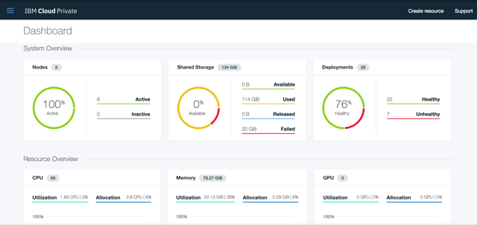
Try IBM Cloud Private today!
Guided and Proof of Technology demos
Free Community Edition!
http://ibm.biz/ICP-DTE
27
27
IBM Cloud / © 2018 IBM Corporation

Slide 28
28

